Slide 1
Feature Flags
By: Zachary McKinnon

Slide 2
Agenda
Definition
Examples
Categories
Techniques
Trade Offs

Slide 3
Definition
AKA: Feature Toggle
My Definition
Decouple Deployments from Releases
Safe Deployment
Notes:
Development - A technique that allows a team to choose when and how a user executes code.
Product - A technique that allows a team to choose when a feature is active.

Slide 4
Examples
GMail
Azure DevOps
Notes:
These are preview flags so they are a good demo, but there are tons that you would never know existed

Slide 5
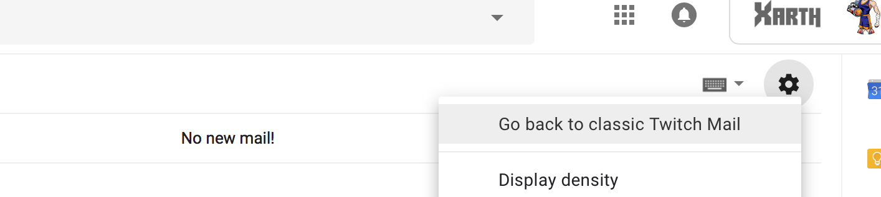
GMail

Slide 6
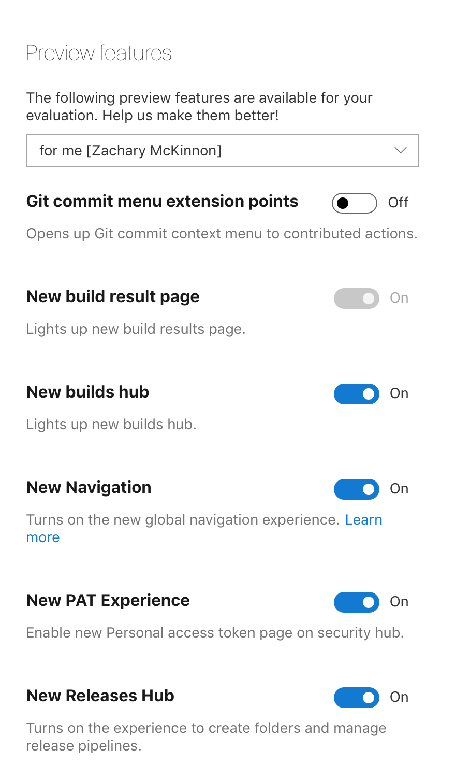
Azure DevOps

Slide 7
Creates Opportunities
Ship unfinished code
Continuous Delivery
A/B Testing
Canary Releases
Champagne Brunch
Trunk Based Development

Slide 8
Reduce Risk
Smaller merges
Deploy More Often

Slide 9
Categories
Release Toggles
Experiment Toggles
Ops Toggles
Permissioning Toggles

Slide 10
Release Toggles
Release Toggles allow incomplete and un-tested codepaths to be shipped to production as latent code which may never be turned on.
Notes:
Separate feature release from code deployment.

Slide 11
Experiment Toggles
Experiment Toggles are used to perform multivariate or A/B Testing.

Slide 12
Ops Toggle
Ops Toggles are used to control operational aspects of our system’s behavior.
Notes:
Hearthpwn issue that we turn off when loads are high.
DynamoDB Elmah logging

Slide 13
Permissioning Toggles
Permission Toggles are used to change the features or the product experience that certain users receive.
Notes:
Champagne Brunch

Slide 14
Techniques
Hardcoded
Configuration File
Database
Third Party
Notes:
Should probably be an abstraction, but the implementation can be anything.

Slide 15
Abstraction
public SuperSecretController(ISuperSecretFeature superSecretFeature)
{
this.SuperSecretFeature = superSecretFeature;
}
private ISuperSecretFeature SuperSecretFeature { get; }
[HttpGet("super-secret")]
public IActionResult Index()
{
if (!this.SuperSecretFeature.IsEnabled)
{
return this.NotFound();
}
return this.View();
}

Slide 16
Hardcoded
public class SuperSecretFeature
{
public string Name => "Super Secret Feature";
public bool IsEnabled => true;
}

Slide 17
Configuration File
public class SuperSecretFeature
{
public SuperSecretFeature(IConfiguration configuration)
{
this.Configuration = configuration;
}
private IConfiguration Configuration { get; }
public string Name => "Super Secret Feature";
public bool IsEnabled => this.Configuration.IsSuperSecretFeatureEnabled;
}

Slide 18
Database
public class SuperSecretFeature
{
public SuperSecretFeature(IFeatureRepository featureRepository)
{
this.FeatureRepository = featureRepository;
}
private IFeatureRepository FeatureRepository { get; }
public string Name => "Super Secret Feature";
public bool IsEnabled => this.FeatureRepository.IsSuperSecretFeatureEnabled();
}

Slide 19
Third Party
Launch Darkly
Split.io

Slide 20
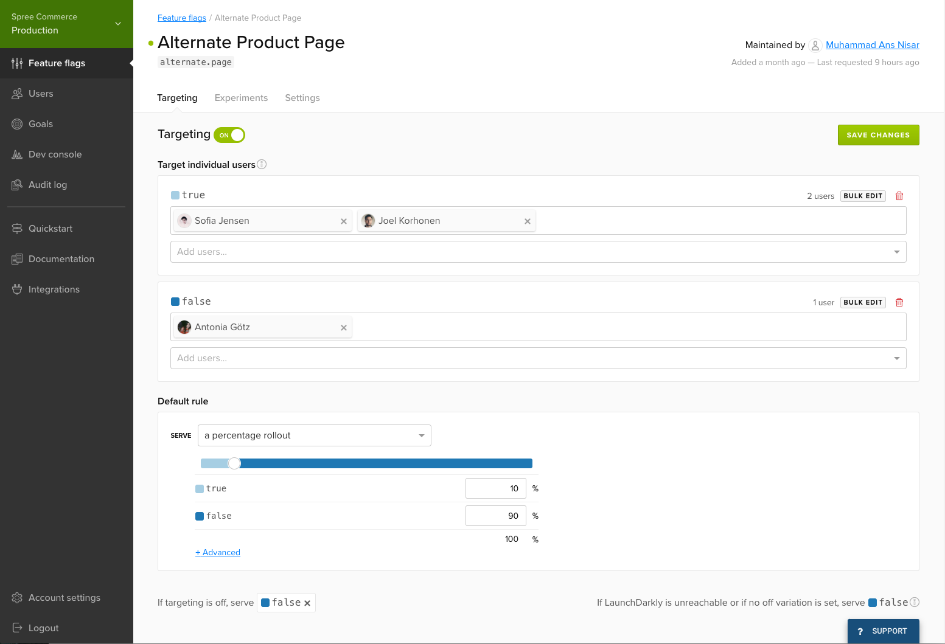
Launch Darkly

Slide 21
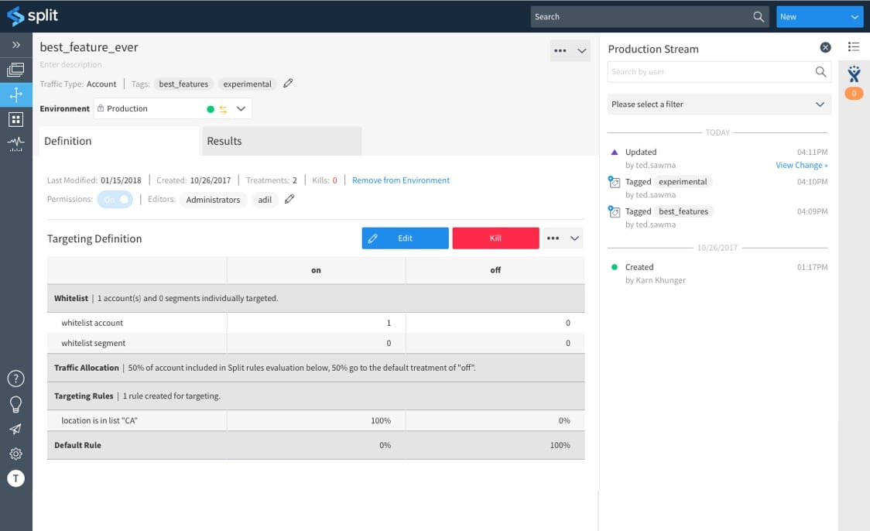
Split.io

Slide 22
Trade Offs
Discipline
Code Complexity
Creates Technical Debt
More to test
Notes:
You need to remove feature flags!

Slide 23
When is a good time to use them?
Major Refactors in functionality
Major UI changes
When you aren’t sure how users will respond to change (A/B Testing and Canary Releases)
When you aren’t sure of the performance impact of a change
When experimenting with new technology
Notes:
Don’t delete code and redo it at the same time. Write the new code on a new path and add a feature flag. Then when it is moved over, delete the old code.

Slide 24
When is not a good time to use them?
Because you saw on awesome Curse U on them
Minor refactors
Low impact changes

Slide 25
Encounter Builder
Notes:
Commit ugly/un-designed code to production as early as possible (Release Toggle)
Default to campaign or build your party (Experiment Toggle)
Refactor to ElasticSearch (Ops Toggle)

Slide 26
References
https://martinfowler.com/articles/feature-toggles.html
https://www.youtube.com/watch?v=lqRQYEHAtpk

Slide 27
Questions

